Slide 1
Decoherence Free Subspaces for 2 Qubits

Slide 2
Motivation
Interested in decoherence free subspaces (DFS) as a way to mitigate charge noise in multiqubit systems
Mark E suggested we come up with 2 qubit experiments to do on a current device

Slide 3
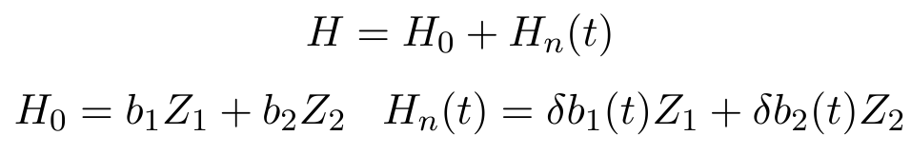
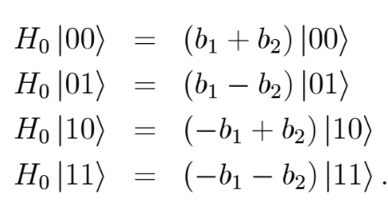

2 Qubit Hamiltonian
If $δb_{ 1}≈δb_{ 2}$ then we can hope to design a strategy to mitigate charge noise using a DFS.
To explore how useful this can be, we want to divide the Hilbert space into two 2-dimensional subspaces (DFS and its complement) and do a Ramsey experiment to extract $T_{2}$ for each. We picture the two subspaces as two-level systems with associated Bloch spheres.

Slide 4
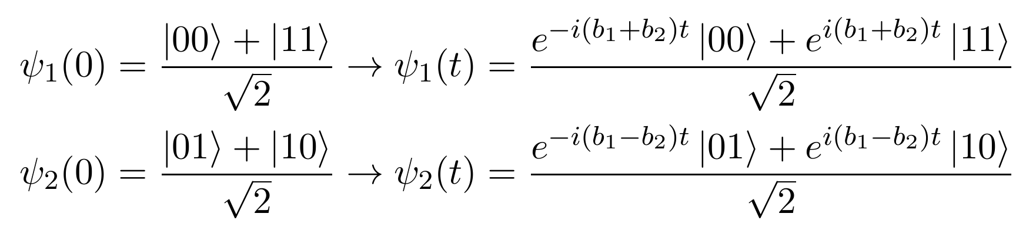
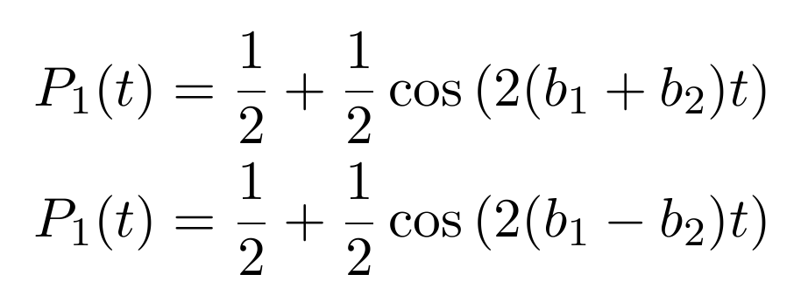

Two Ramsey Experiments
Prepare two states $ψ_{1}\left(0\right),ψ_{2}(0)$ and allow them to evolve under $H_{0}$ for a time t.
Rotate $ψ_{1}(t)$ and $ψ_{2}(t)$ by $\frac{π}{2}$ around Y on the Bloch sphere and measure the probability of being in |11> or |10>.

Slide 5
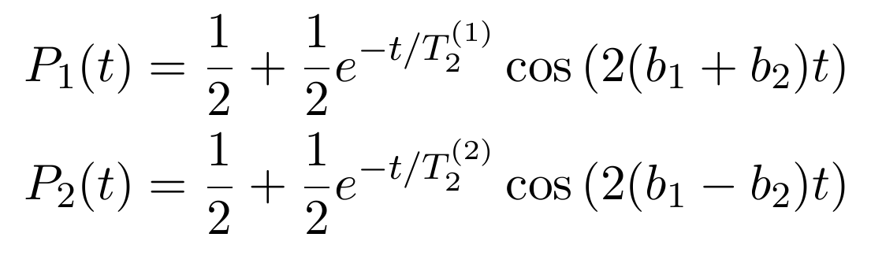
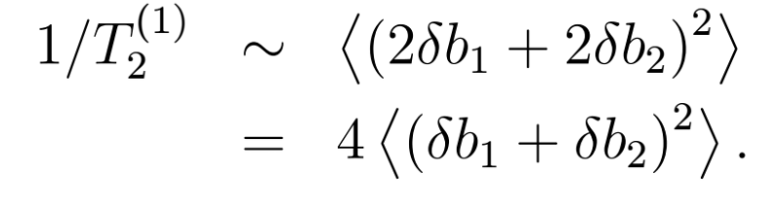
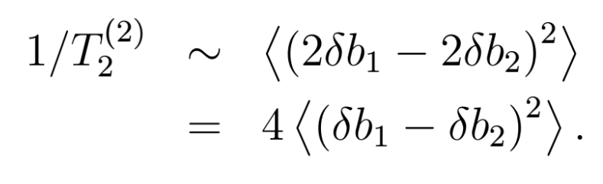

Effect of noise
Including the effect of $H_{n}(t)$ will change these probabilities to

Slide 6
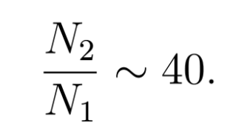
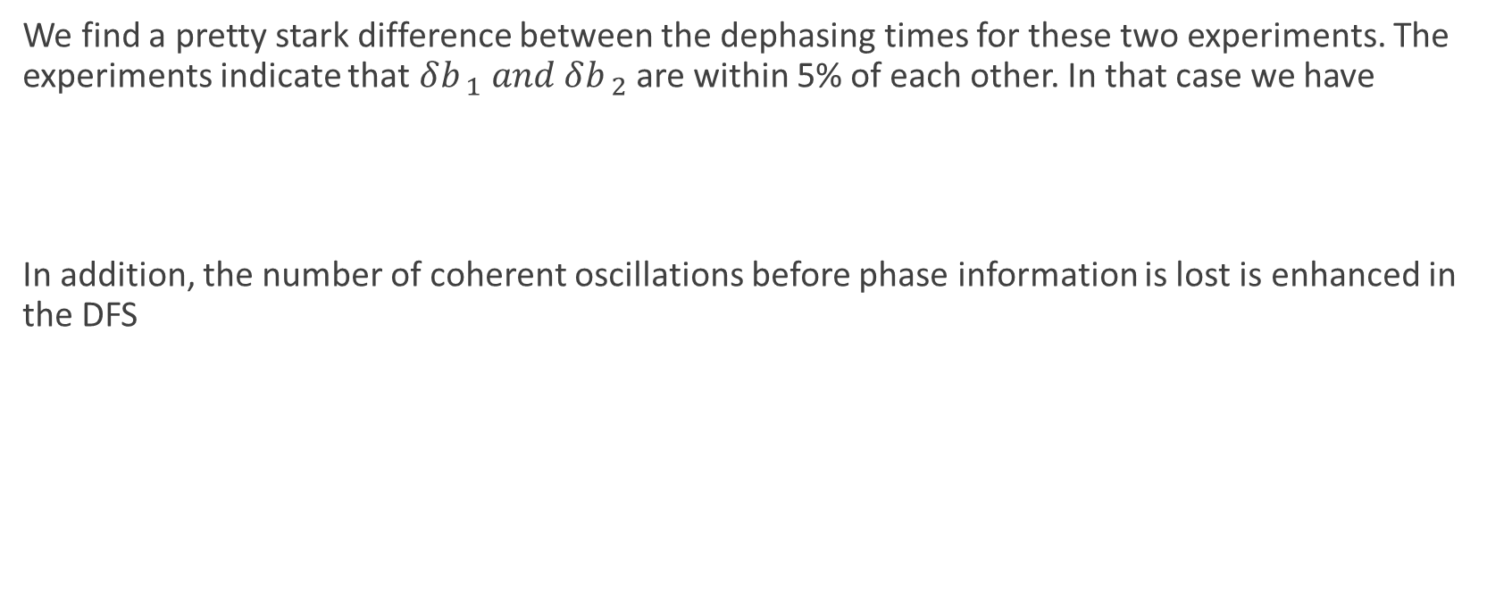
Comparison
We find a pretty stark difference between the dephasing times for these two experiments. The experiments indicate that $δb_{ 1} and δb_{ 2}$ are within 5% of each other. In that case we have
In addition, the number of coherent oscillations before phase information is lost is enhanced in the DFS

Slide 7
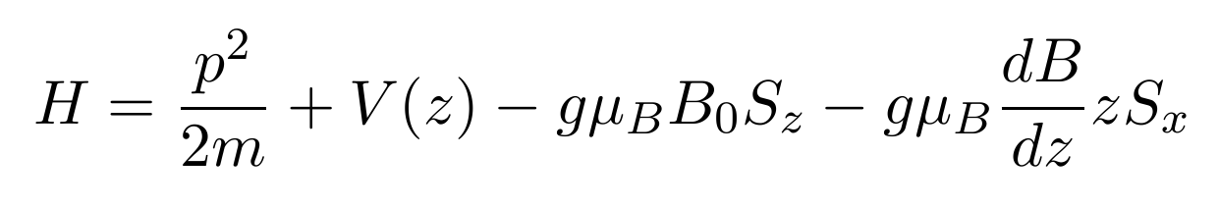
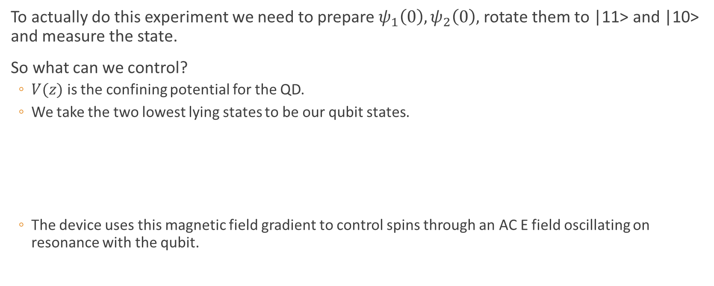
Experimental Protocol
To actually do this experiment we need to prepare $ψ_{1}\left(0\right),ψ_{2}\left(0\right),$rotate them to |11> and |10> and measure the state.
So what can we control?
$V(z)$ is the confining potential for the QD.
We take the two lowest lying states to be our qubit states.
The device uses this magnetic field gradient to control spins through an AC E field oscillating on resonance with the qubit.

Slide 8
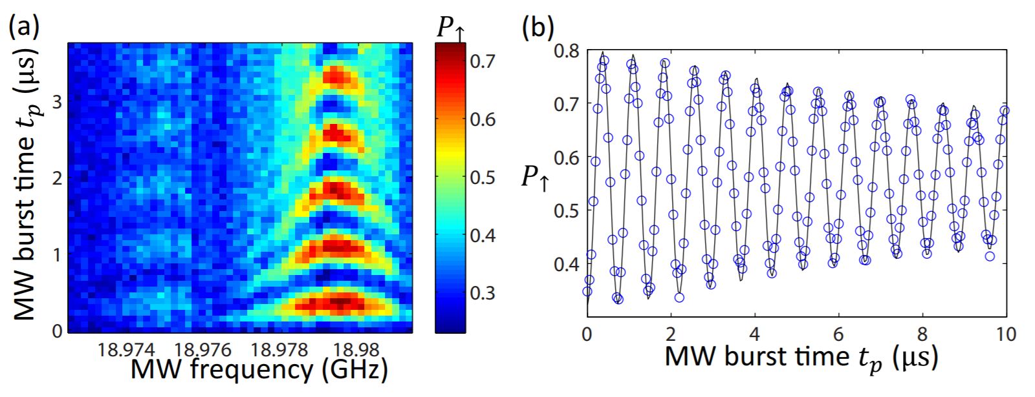
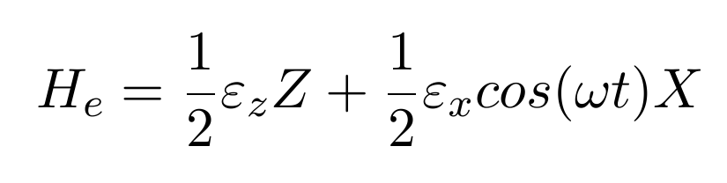

Electrical Control
The AC field is included as $H_{1}\left(t\right)=e V_{0}z cos\left(ωt\right).$ If the confining potential is symmetric, then this time-dependent Hamiltonian has 0 along the diagonal in the basis of the two qubit states we have chosen.
We are left with the effective qubit Hamiltonian
$ε_{x}$ and $ε_{z}$ depend on many things, including the confining potential, static B field, etc. The thrust of this is that we can do Z and X rotations.
Two qubit gates are done by allowing neighboring wavefunctions to overlap, resulting in an interaction like $H_{2q}=J\left(t\right) S_{1}{∙S}_{2}$

Slide 9
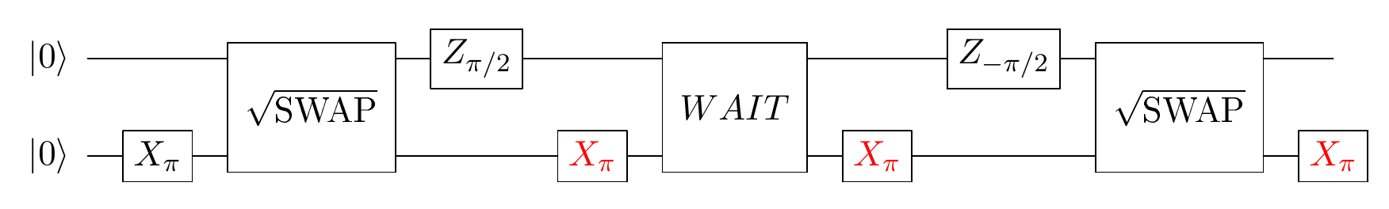

Gate Sequence for Ramsey Experiments
As it turns out, we can do the experiments using only Z rotations on qubit 1, X rotations on qubit 2, and two $\sqrt{SWAP}$ gates.
The red gates should be included for the |00>, |11> experiment and excluded for |01>, |10> case.
In both cases, the system is mostly in the DFS. The red gates take the state out of the DFS right before the wait period. F = .99 and .9 for one- and two- qubit gates respectively.

Slide 10
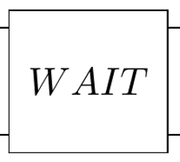
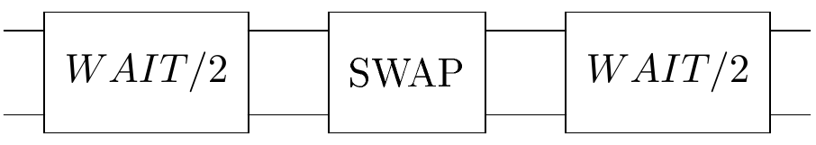


Extending $T_{2}$ with an Echo
Performing a SWAP halfway through the wait period will result in an echo, and a longer dephasing time
This comes at the cost of introducing another 2 qubit gate.

Slide 11
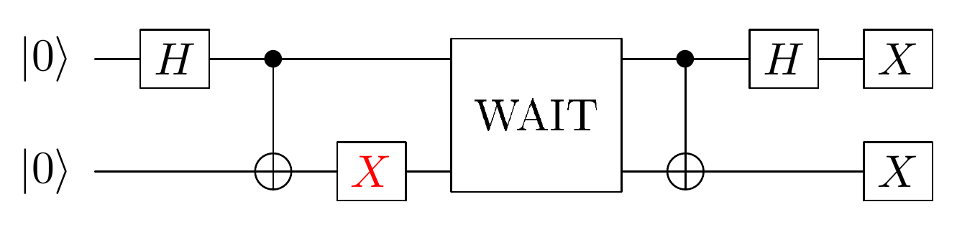
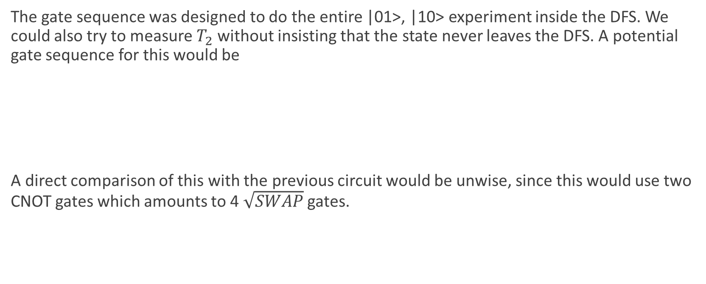
Gates outside the DFS
The gate sequence was designed to do the entire |01>, |10> experiment inside the DFS. We could also try to measure $T_{2}$without insisting that the state never leaves the DFS. A potential gate sequence for this would be
A direct comparison of this with the previous circuit would be unwise, since this would use two CNOT gates which amounts to 4 $\sqrt{SWAP}$ gates.

